Slide 1
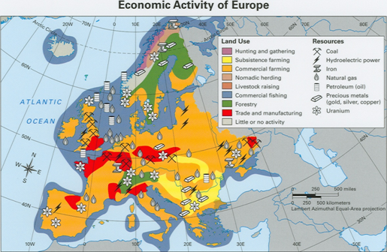

Slide 2
Station 1: Economic Activity
What land use is represented by the color red?
What resource can be found on the border of Spain and France?

Slide 3
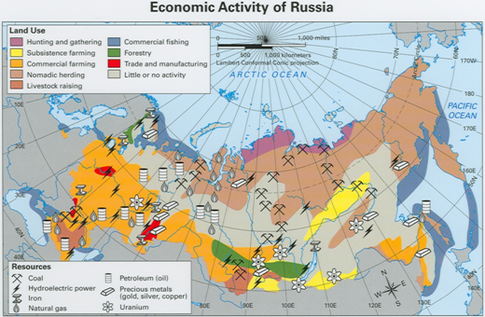

Slide 4
Station 1: Economic Activity
What land use is represented by the color purple?
What are the top two land uses in Russia (other than “little or no activity”)?

Slide 5
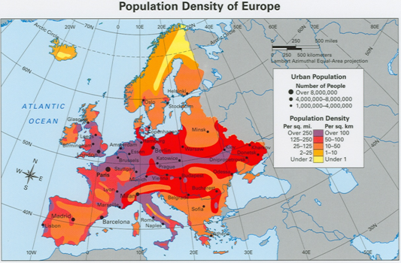

Slide 6
Station 2: Population Density
What is the dominant population density for Iceland?
Name 4 cities that have 4,000,000-8,000,000 people.

Slide 7
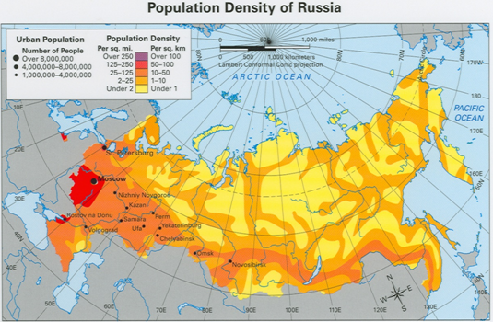

Slide 8
Station 2: Population Density
What are the two dominant densities for Russia?
Why do you think that for #4 above?

Slide 9
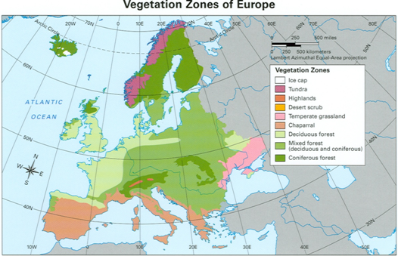

Slide 10
Station 3: Vegetation Zones
What vegetation zone is dominant in Italy?
What vegetation zone covers most of Europe?

Slide 11
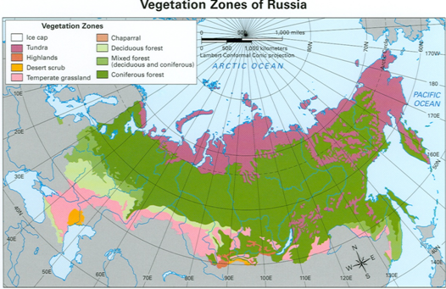

Slide 12
Station 3: Vegetation Zones
What vegetation zone is represented by the color pink?
2. What vegetation zone is dominant in Russia?

Slide 13
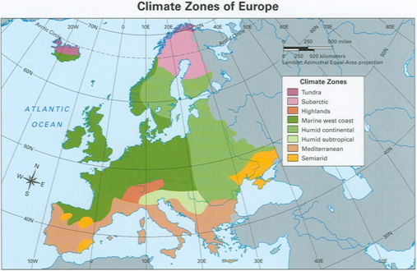

Slide 14
Station 4: Climate Zones
What climate zone covers the United Kingdom?
What climate zone is represented by the color orange?

Slide 15
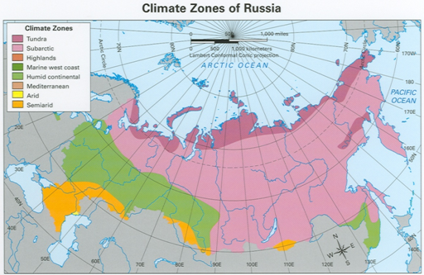

Slide 16
Station 4: Climate Zones
What climate zone covers most of central and eastern Russia?
What climate zone is found in the most northern part of Russia?

Slide 17
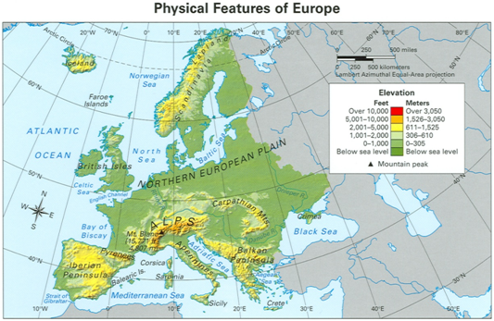

Slide 18
Station 5: Physical Features
If you travel by boat from England (part of the UK) to Norway, what body of water would you travel through?
What mountain peak in Europe has an elevation of 15,771 ft.?

Slide 19
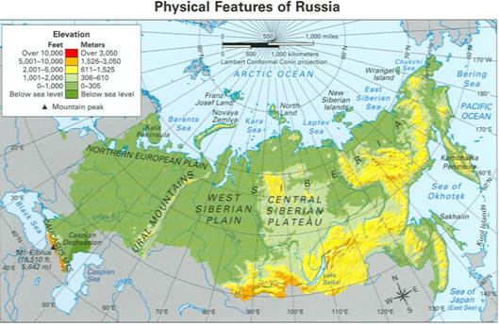

Slide 20
Station 5: Physical Features
What mountain range runs vertical in western Russia?
What mountain peak can be found in the Caucasus Mountains?

Slide 21
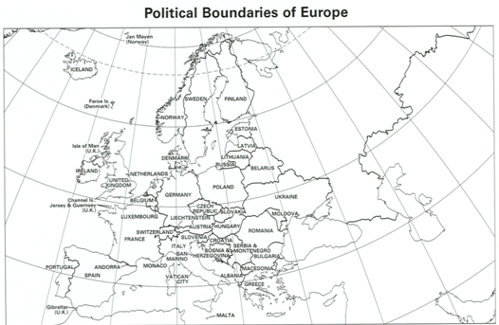

Slide 22
Station 6: Political Boundaries
Name 3 countries that are peninsulas.
What country is made up of a bunch of small islands?

Slide 23
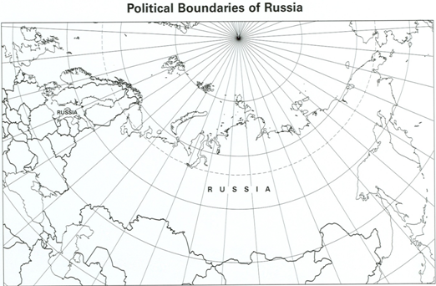

Slide 24
Station 6: Political Boundaries
If you were traveling by train and going from Latvia to Ukraine, what country would you travel through?
2. How many countries border Russia? Please list them.

