Slide 1
Unit 1 Vocab

Slide 2
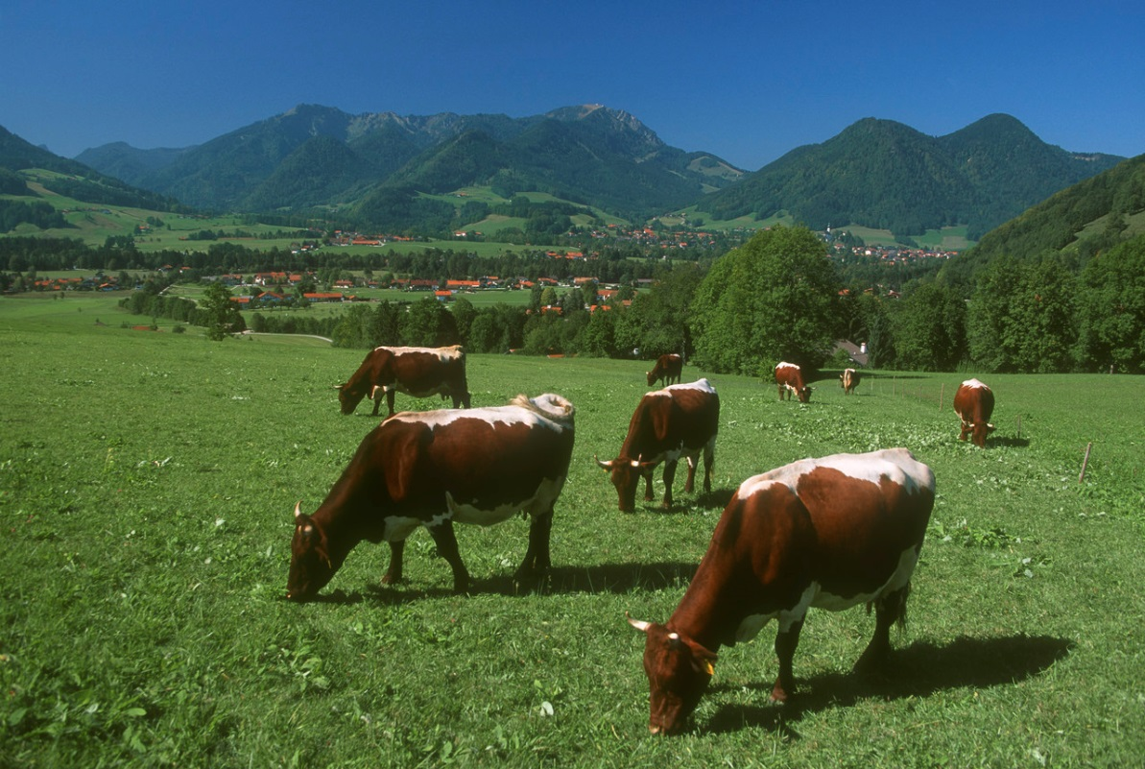
Agriculture
Agriculture is the domestication of plants and animals for food. This includes farming and ranching.

Slide 3
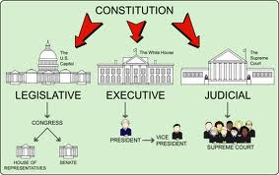
Check and Balances
The idea that no part of a government is stronger than another. Each branch of our three branch government has powers to control the reach of the other two branches.

Slide 4
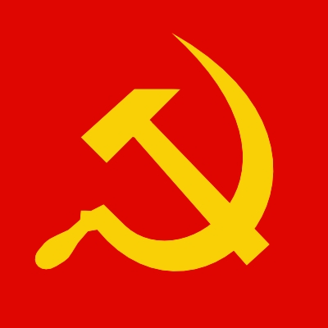
Communism
An economic and political system in which property is owned collectively and labor is organized in a way that is supposed to benefit all people

Slide 5
Constitutional government
A government that receives its power from a constitution. People’s rights and responsibilities are covered in this constitution.

Slide 6
Democracy
A form of government in which power is held by the people. The people exercise their power either directly or through elected representatives.

Slide 7
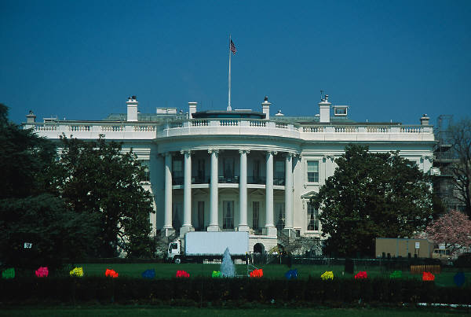
Federalism
(federal system)
A form of government in which power is divided between a central government and state and local governments.

Slide 8
Free Enterprise System
The freedom of private business to operate competitively for profit with minimal government regulation.

Slide 9
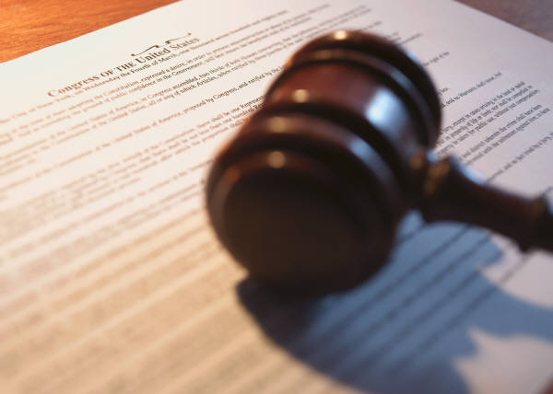
Individual Rights
(natural rights)
Such basic rights as those to life, liberty, and property.

Slide 10
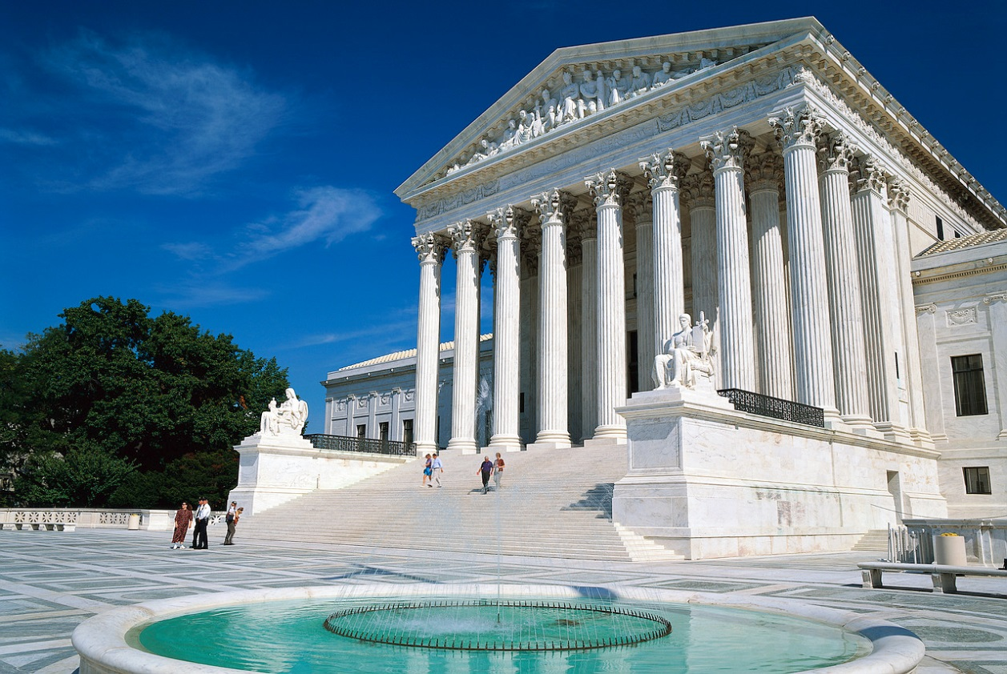
Limited Government
A government that is limited in its power over its people. Usually, that limitation is written into law by a constitution or a bill of rights.

Slide 11
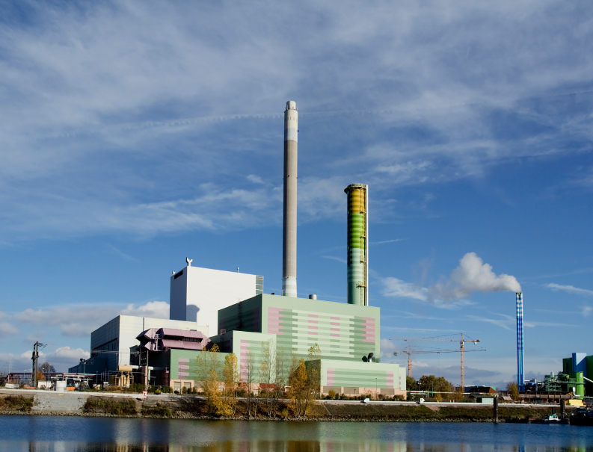
Manufacturing
To make or process raw materials into finished products.

Slide 12
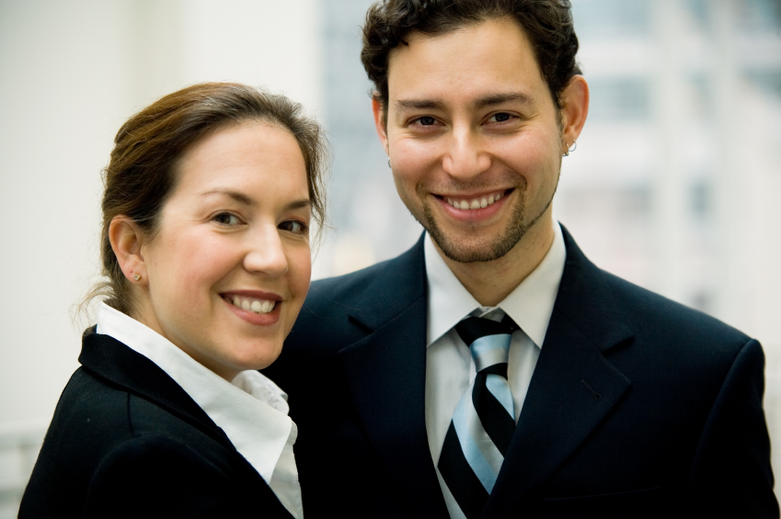
Republicanism
(republican government)
A government in which power is held by the people who elect representatives to run the government for the common good. The term does not refer to a political party.

Slide 13
Retail
The sale of goods or commodities in small quantities to the consumer.

Slide 14
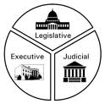
Separation of Powers
The division of powers among the different branches of government. In the United States, powers are divided among the legislative, executive, and judicial branches.

Slide 15
Service Industry
Employment or work in duties for another.

Slide 16
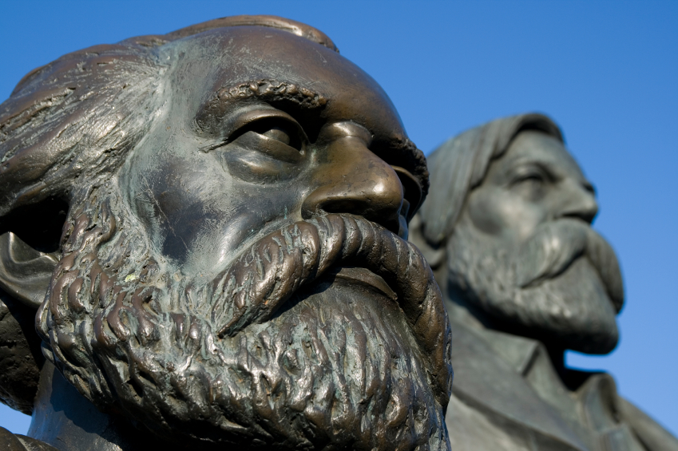
Socialism
A system of government where the production of goods and services are monitored and produced for the common good.

Slide 17
Totalitarian
A government in which one person or family exercises absolute (total) control over all areas of human life and opposing parties are not permitted to exist.

Slide 18
Wholesale
The sale of goods or products in large quantities as for resale by a retailer (store).

Slide 19
Unlimited Government
A government that has no controls over what it can do to its people. Usually there is no constitution or law that the ruler/rulers have to follow and the people have no protections from their government.

